Slide 1
Centralized Energy
Meter
By
Akhil Basil Baby(4)
Akhil joy(5)
Jibin Poulose(29)

Slide 2
Contents
Introduction
Existing system
Proposed system
Working
Circuit Diagram
Program
Conclusion
Reference

Slide 3
Introduction
A high percentage of electricity revenue is lost due to
Power theft
Incorrect meter reading , billing
Reluctance of consumers towards paying electricity bills on time . .
Works on prepaid mode /postpaid mode
According to network availability

Slide 4
Existing systems
Electromechanical & digital electronic meters
Problems
Incorrect meter reading and billing
Reluctance of consumers towards paying
electricity bills on time.
Power theft

Slide 5
Proposed system
Meter which can operate on both prepaid and postpaid systems .
Communicate remotely with the energy supplier
Automatically send readings , receive the present tariff rates and recharge requests.

Slide 6
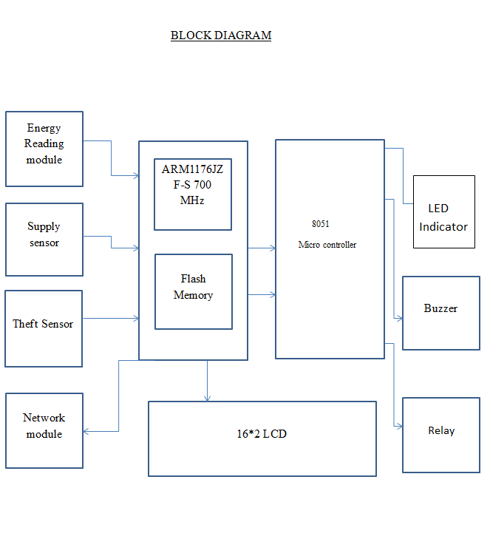
Main Contents
Energy reading module
Supply sensor
Network module
16*2 Lcd
8051 micro controller
Raspberry pi
(Arm processor)
Flash memory
Led indicator
Buzzer
Relay

Slide 7
Working
Reads energy meter and save in an input file.
Process calculations based on the tariff rates and save the new balance .
Remotely send the meter reading and balance amount
Receive recharge requests and change in tariff rates if any

Slide 8
Recharge amount is added with current balance amount
Balance is monitored continuously
if it goes below a certain limit , warning information is given to the consumer .
Supply is automatically cut off if balance is zero

Slide 9
Theft monitoring
Reading from transformer and individual consumed is continuously monitored .
Power Theft =
{[Output Energy supplied by distribution Transformer ]- [Pre calculated loss +
Sum of Individual Energy consumed }

Slide 10
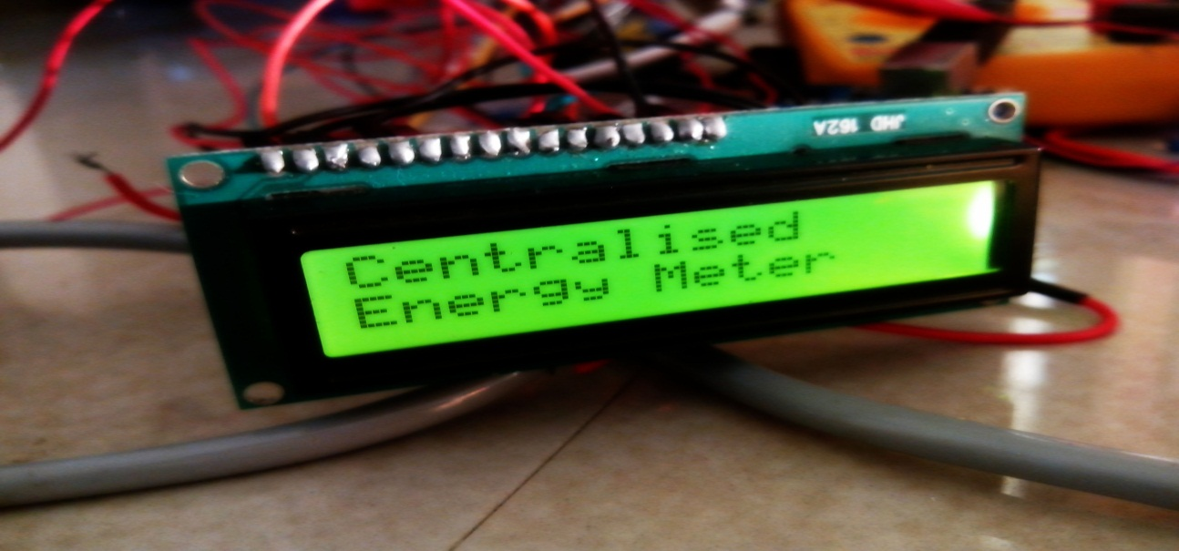
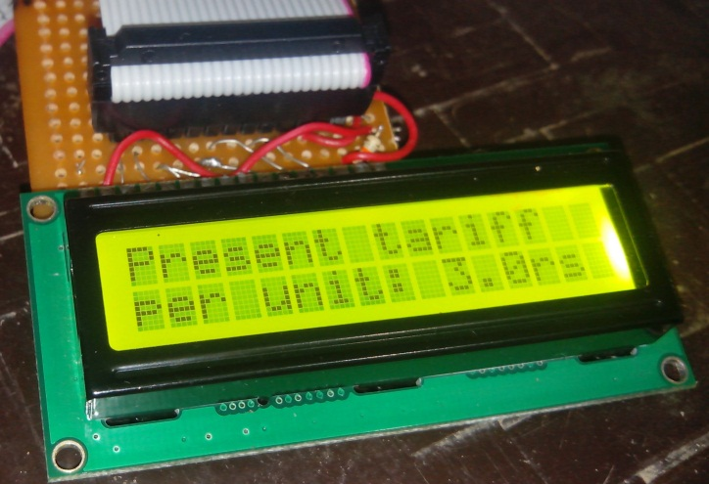
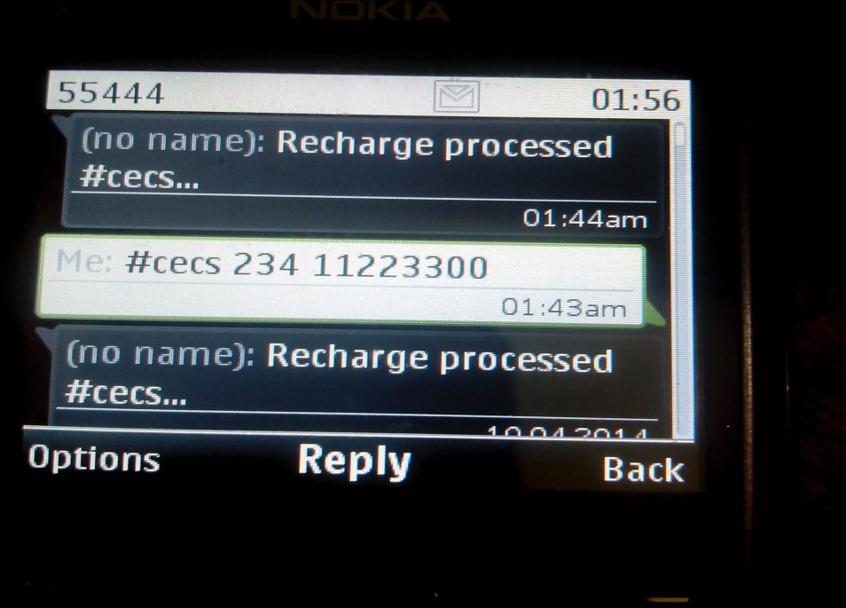
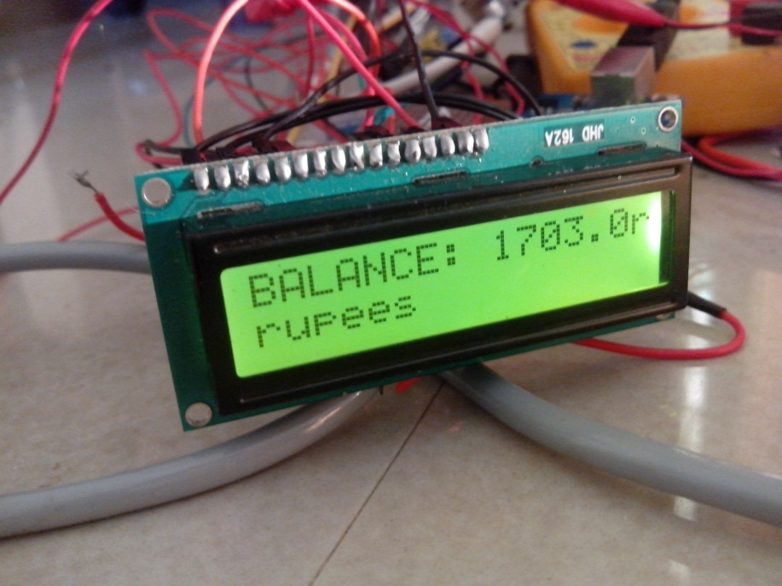
Images

Slide 11
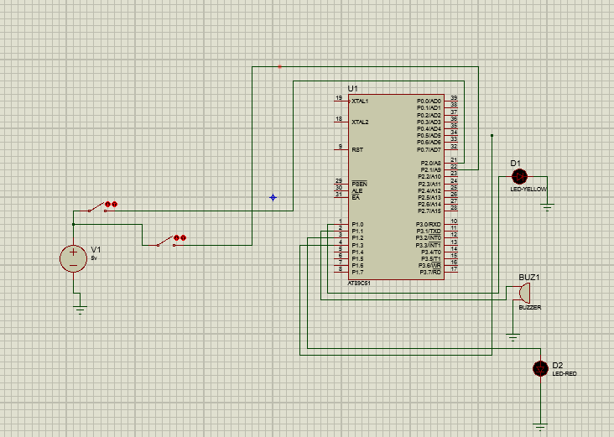
Proteus simulation of 8051

Slide 12
Program on 8051
MAIN:MOV P1,#00H
MOV P2,#00H
JB P2.1,CUT
JB P2.0,ALARM
SJMP MAIN
CUT:SETB P1.2
SETB P1.3
SETB PI.1
SJMP MAIN
ALARM:SETB P1.0
SETB P1.1
ACALL DELAY
END

Slide 13
DELAY:MOV R1,#50H
H1:MOV R2,#0FFH
H1:DJNZ R2,H1
DJNZ R1,DELAY
RET

Slide 14
Advantages
Display Real time Pricing
Theft Monitoring
Online Billing
Complete replacement of TOD meter
Consumer can budget and manage his electricity more effectively.
No meter reading necessary
Reduced billing cost (Printing & mailing)
Convenience of electricity purchases

Slide 15
Flexibility in changing tariff rates and setting prepaid recharges
Individual customization of energy charges (APL \ BPL)
Disadvantages
Network availability is required
High Installation charges
Communication costs

Slide 16
Conclusion
Looking at the benefits the system provides, there is a need to give it a policy support and implement it on a large scale all across.
A better solution for energy management and beneficial to consumers and suppliers . A prototype for customer terminal is successfully simulated.

Slide 17
Reference
Google Power Meter
www.google.com/powermeter
The 8051 Microcontroller And Embedded Systems
By Mazidi

Slide 18
Thank You

